Slide 1

━Grand Park Otaru━

Slide 2


About Park Hotel Group
Singapore-based Park Hotel Group is one of Asia Pacific’s best hospitality groups
Owns and/or manages 16 properties across 8 countries and 11 cities, under the luxury “Grand Park”, upscale “Park Hotel” and midscale “DESTINATION” brands
Over 4,500 rooms in the region’s key gateway cities
15 Global Sales Offices in Asia, Australia, United Kingdom (UK) and The United States of America(USA)

Slide 3
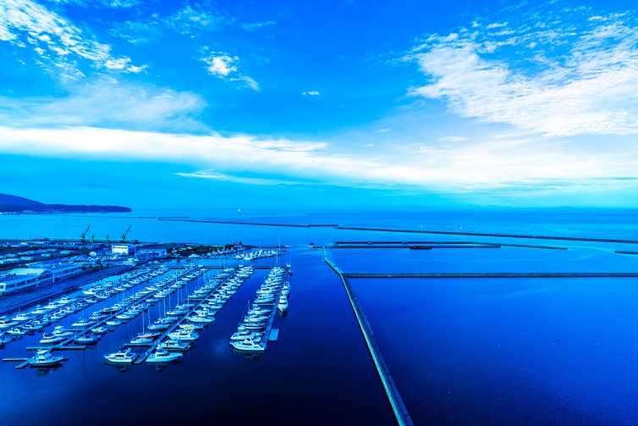
Discover Japan – Otaru (Hokkaido)
An enchanting seaport town, about half hour from Sapporo by train
Nestled between mountains and Ishikari Bay, Otaru is well-known for its bountiful fresh seafood from its fishing port
An array of fun-filled activities such as fruits picking, DIY music boxes, whisky tasting and skiing is available

Slide 4
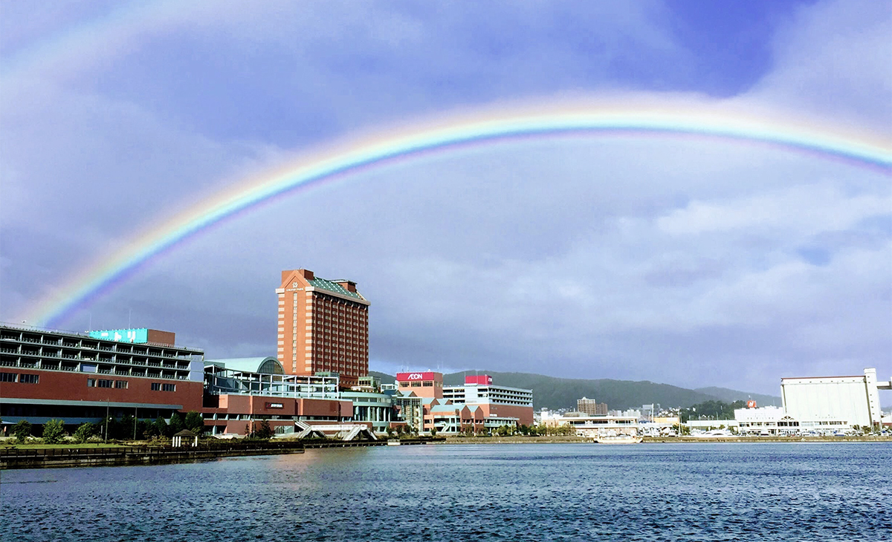
Grand Park Otaru
The only Deluxe and International hotel in Otaru
Overlooking the stunning Ishikari Bay and in the heart of Otaru’s best shopping, sightseeing and skiing spots

Slide 5
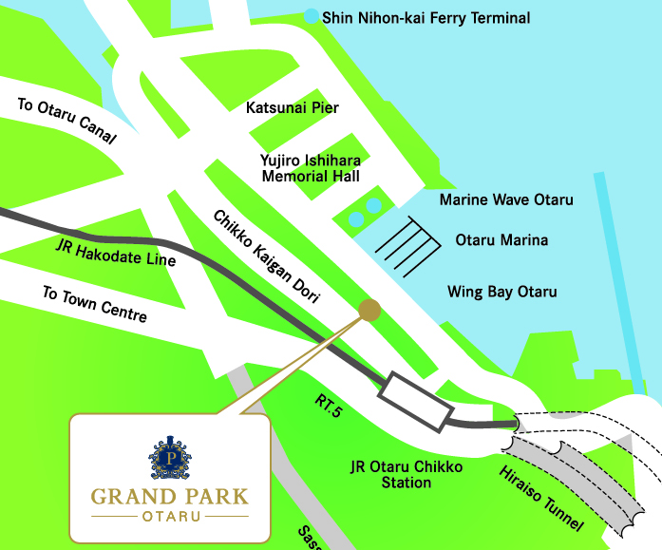
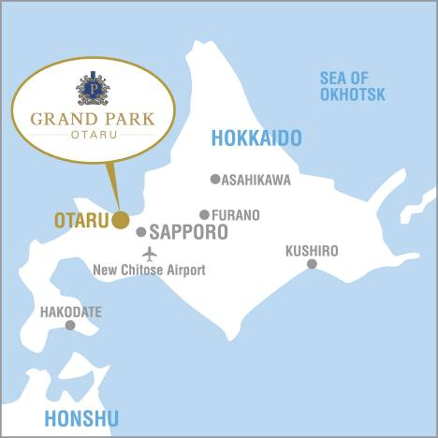
Around The Hotel
Within minute walk to Otaru Marina
5 minutes’ walk from Otaru Chikko Station
7 minutes’ drive to Otaru Canal
Other Surroundings
Distance Time Required
Sapporo 36km 30min. by JR Rapid Train
New Chitose Airport 85km 65min. by JR Rapid Train
Yoichi 30km 40min. by car
Kiroro 25km 45min. by car
Niseko 83km 1.5hour by car
Lake Toya 115km 2.5hour by car

Slide 6
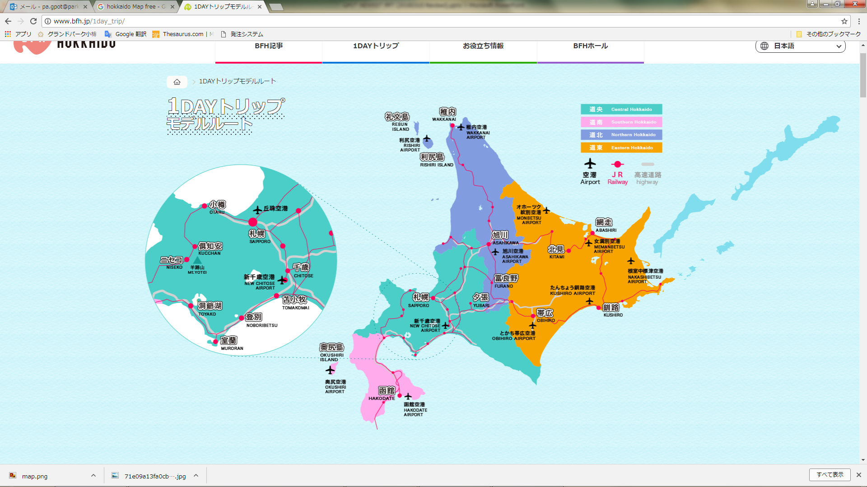
Hokkaido Trip
Route Suggestion
1st Day
2nd Day
3rd Day
4th Day
New Chitose Airport
Shiraoi Ainu Sightseeing
Noboribetsu Stay (Hot spring)
Noboribetsu or Toya Sightseeing
Kyogoku Natural Water Park Sightseeing
Otaru Stay (Resort)
Otaru Sightseeing
Yoichi (Fruits picking, Nikka Whisky Factory)
Sapporo Stay (City)
Sapporo Sightseeing
New Chitose Airport

Slide 7
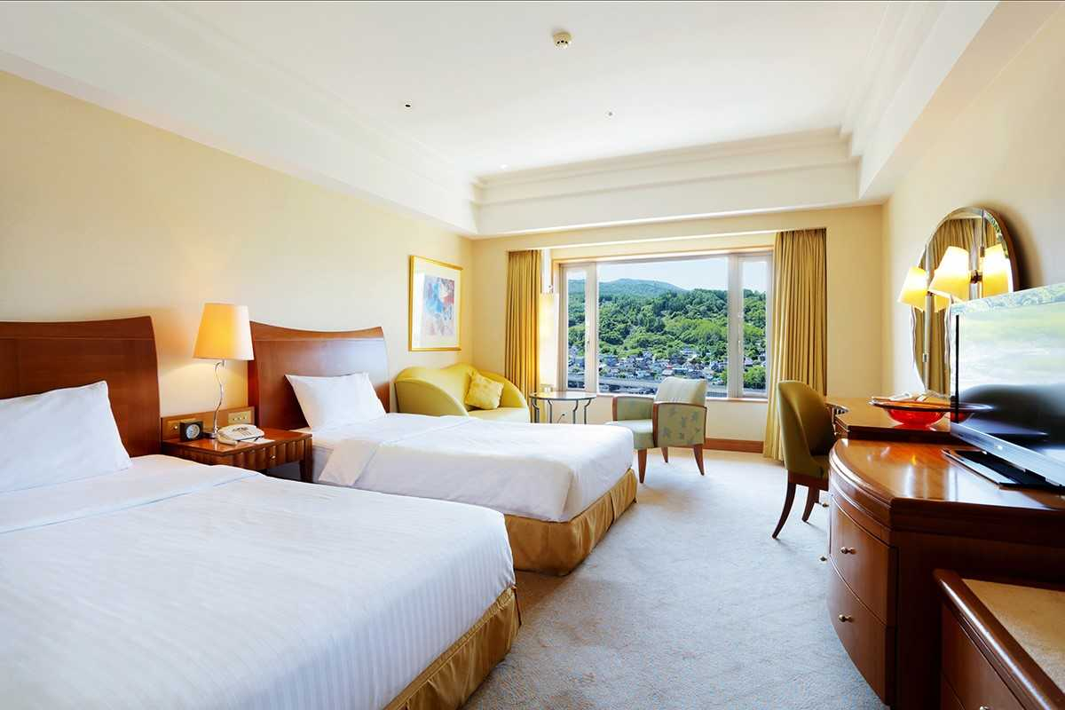
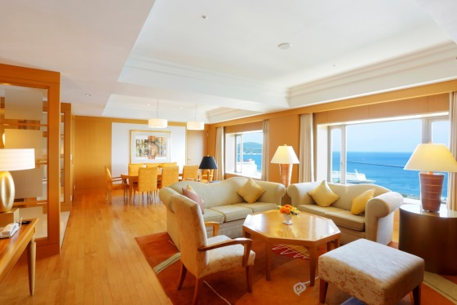
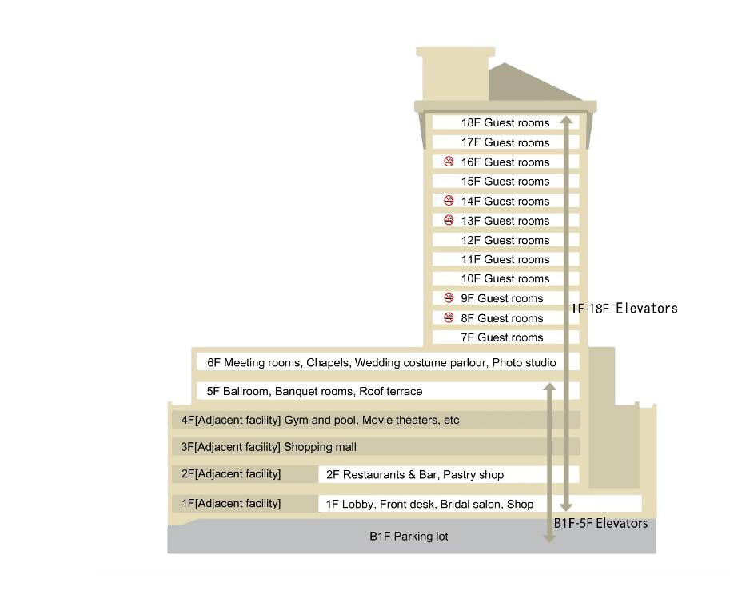
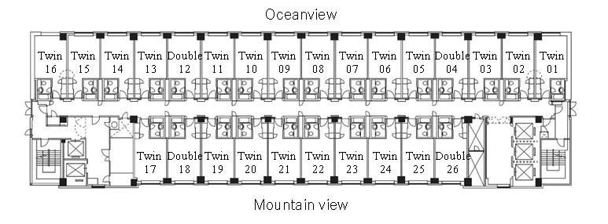
Guestrooms
Wake up to breathtaking views of vast ocean or mountain ranges from the rooms. Designed in soothing neutral tones, the interiors exude modernity combined with traditional touches of Japanese elegance

Slide 8
296 modern guestrooms infused with subtle touches of Japanese heritage

Slide 9
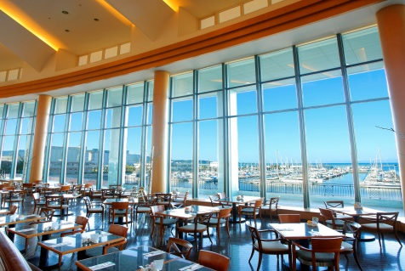

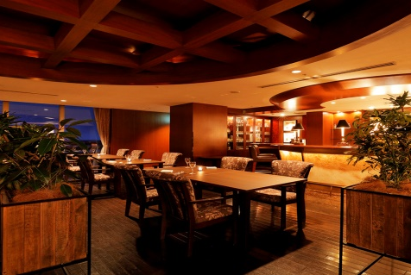



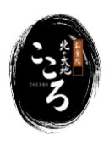
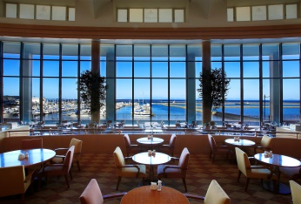
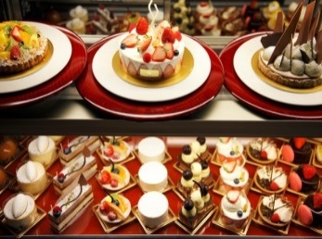
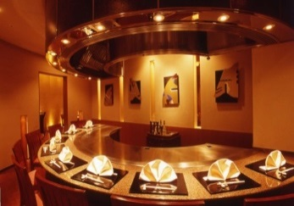
Restaurants / Bars
2F Terrace Brasserie
6:30am-8:00pm
2F Marina Bar & Restaurant
5:00pm-11:00pm
Enjoy delectable Italian and Asian buffet spread amidst relaxing views of Ishikari Bay through majestic floor-to-ceiling windows
Offers a repertoire of signature cocktails and fine wines from all over the world
2F Bay Lounge
10:00am-10:00pm
Indulge in a classic lounge experience with delectable homemade cakes perfectly paired with coffee or teas
2F Patisserie
10:30am-8:30pm
Features homemade exquisite pastries, breads and desserts
2F Cocoro
5:30pm-9:00pm
Recommends bookings made in advance
Features an action counter serving up traditional Japanese fare and Teppanyaki specialties;
Private Tatami rooms are also available

Slide 10
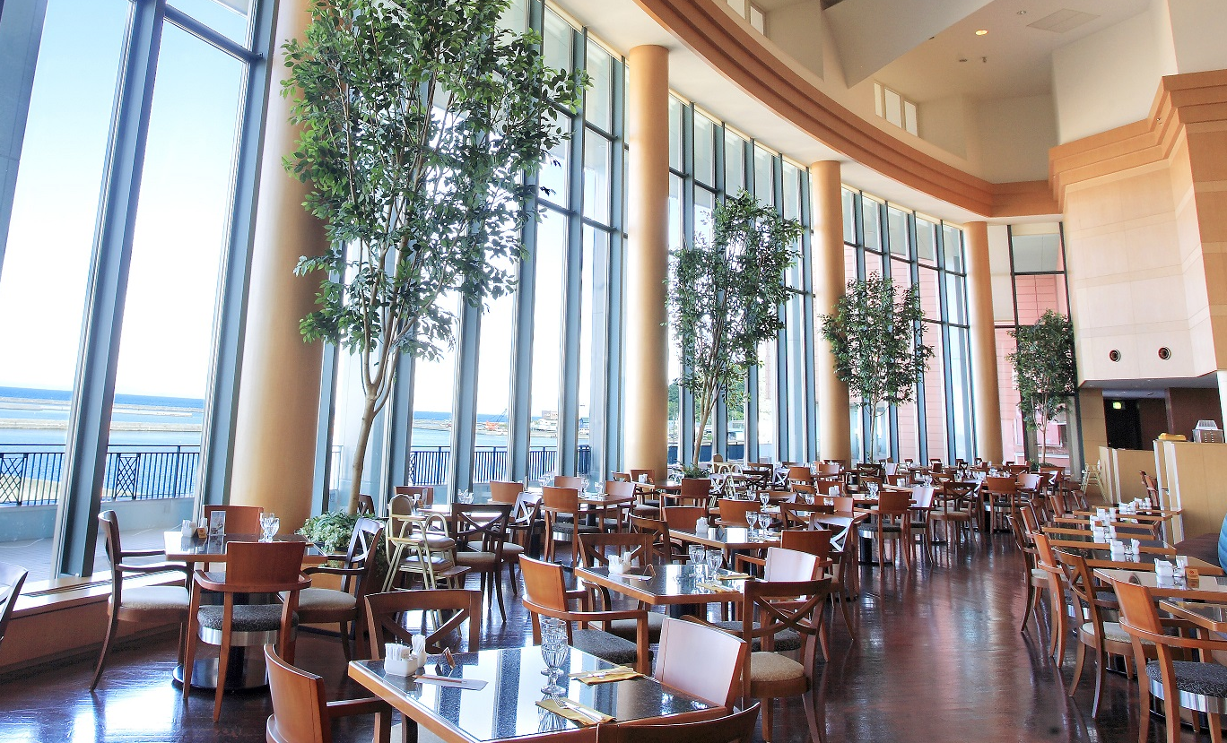
Five restaurants and bars offering international buffet and the freshest local specialties

Slide 11
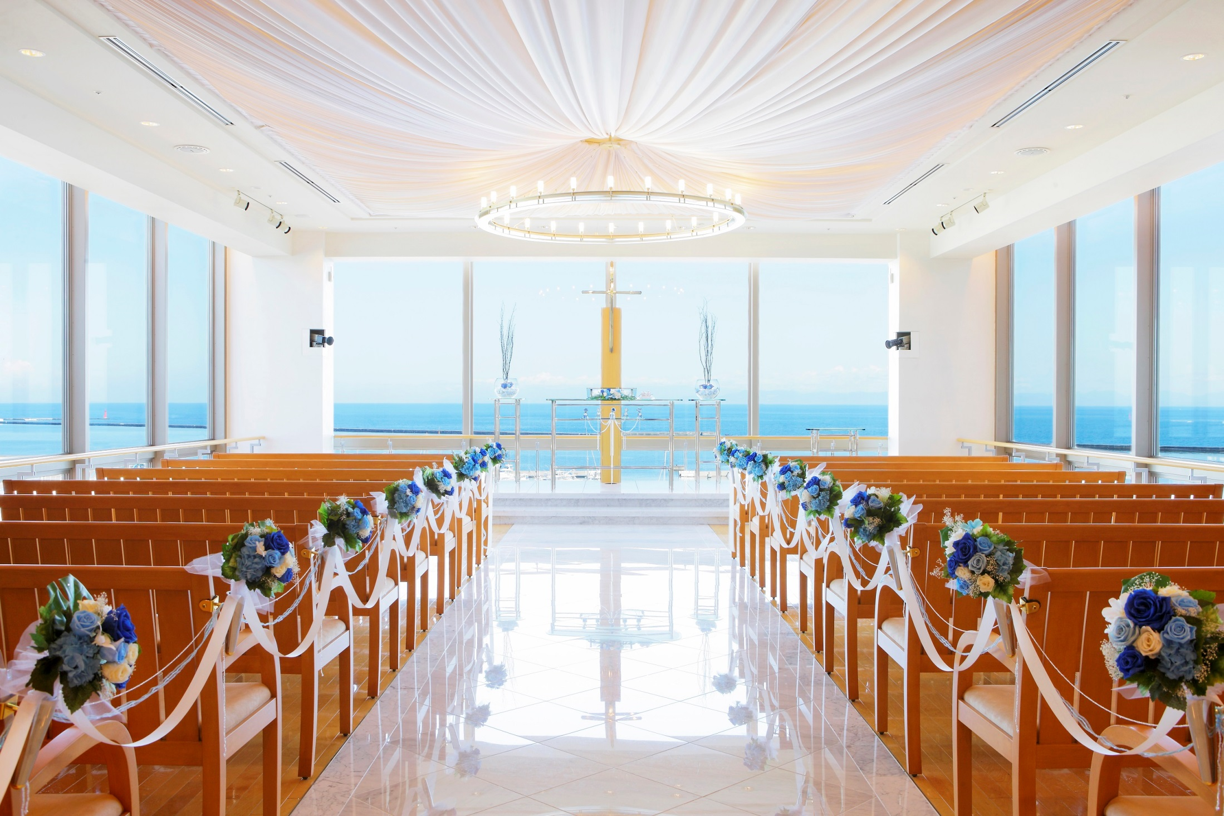
10 function rooms and two chapels, set against vast skies and sea views

Slide 12
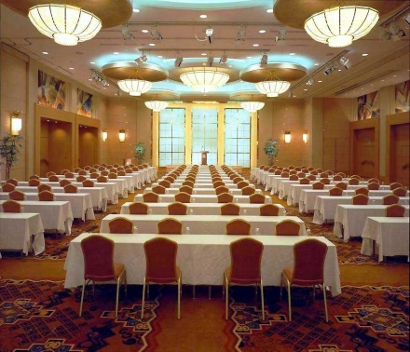
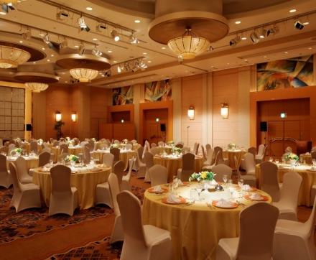
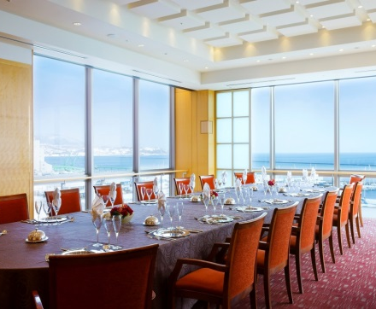
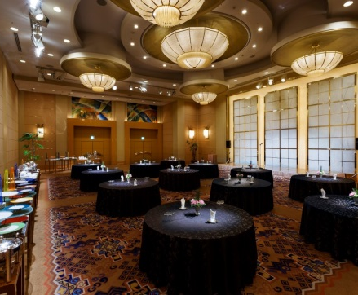
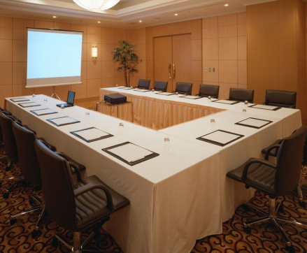
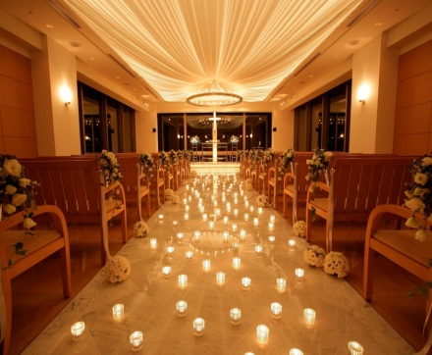
Meetings and Events
Dedicated meeting floors on level 5 and 6 offering complimentary hotel-wide Wireless Internet access
Western and Japanese style chapels are located on level 6

Slide 13
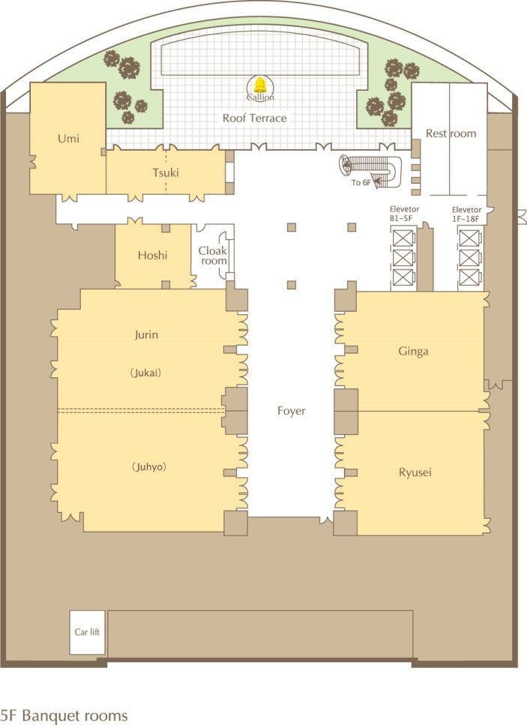
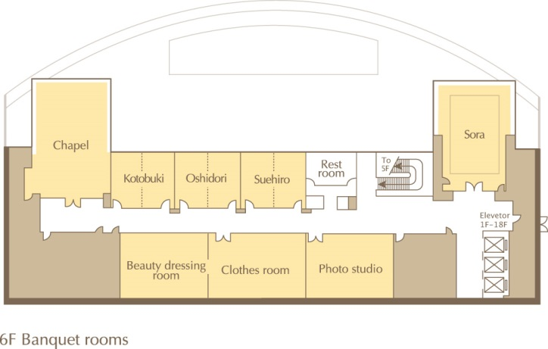
Meetings and Events
5F : Ballroom and Banquet Rooms
6F : Ballroom and Banquet Rooms

Slide 14
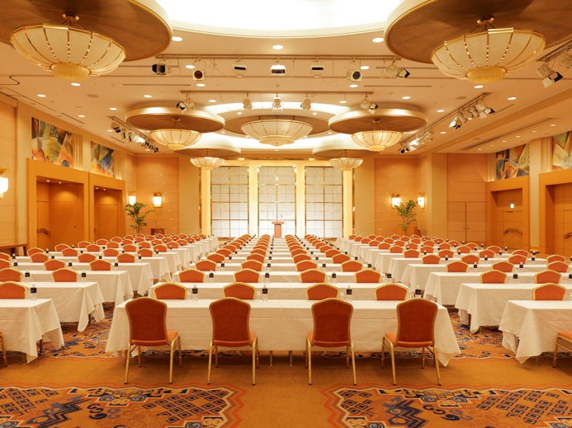
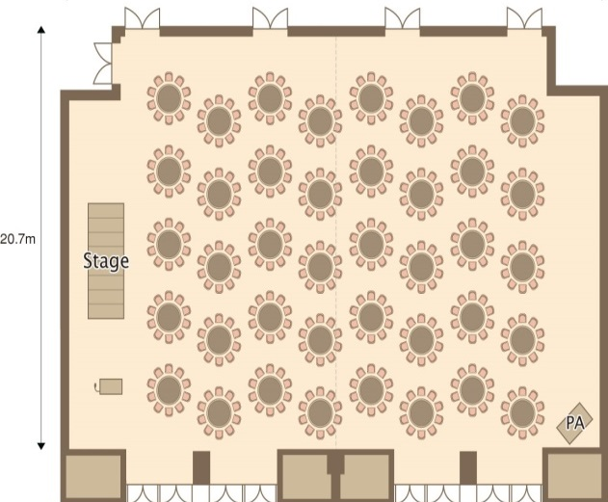
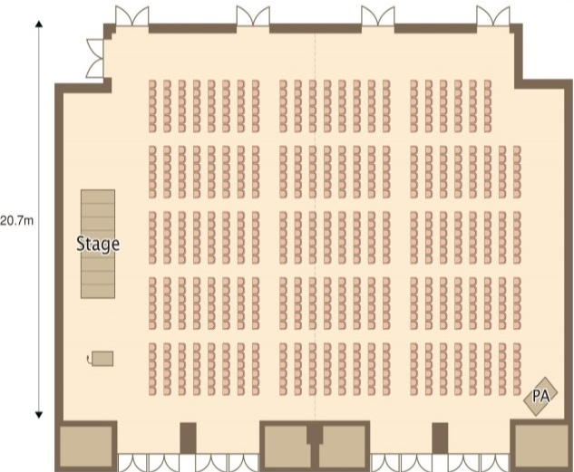

Banquet and Events
5F JURIN
Area 682 square meters
(Configurable into 2 rooms)
Footage 31.3m
Depth 20.7m
Ceiling 7.0m
High speed LAN
Screen more than 150inches
Stage (120cm x 240cm)
Microphones : wired 4, wireless 4
Round Table (180cm in diameter)
Theatre

Slide 15
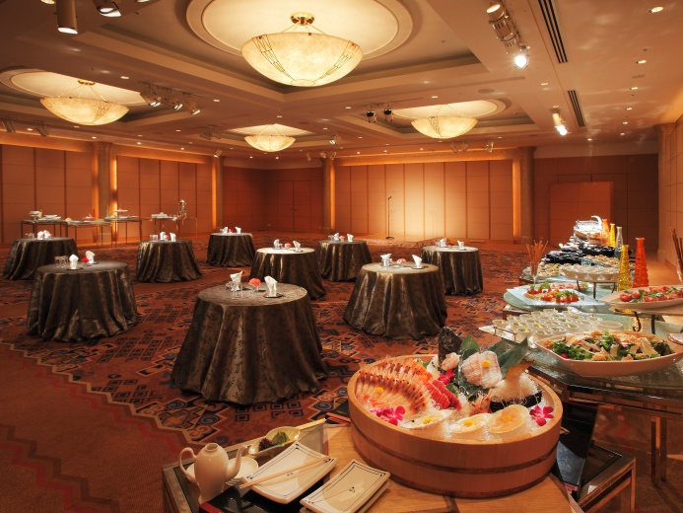
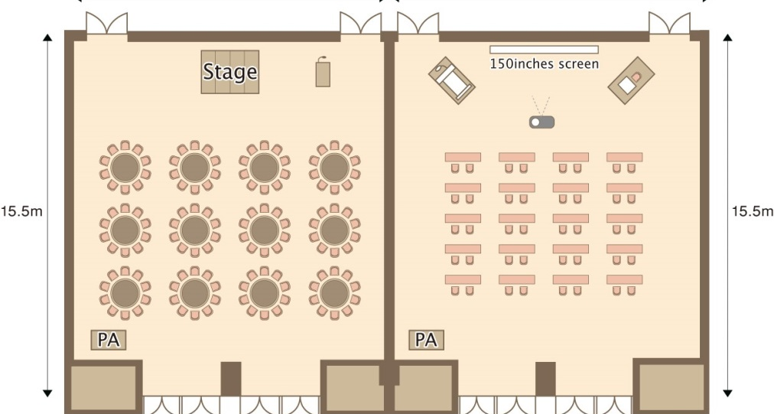
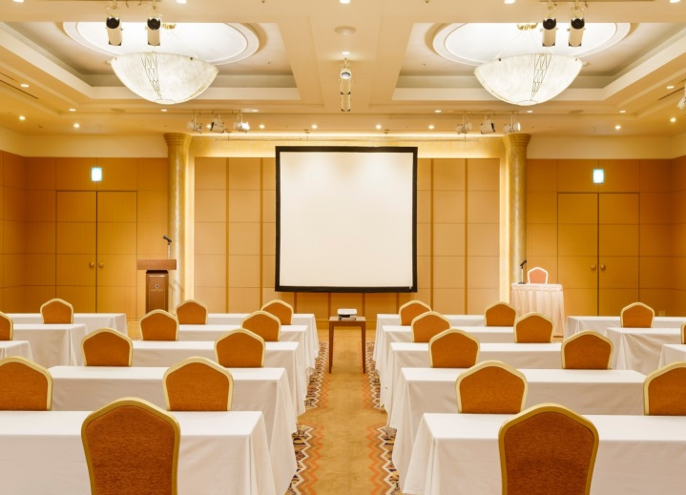
Banquet and Events
5F GINGA / RYUSEI
Area 242 square meters
Footage 15.3m
Depth 15.5m
Ceiling 4.0m
High speed LAN
Screen more than 100inches
Stage
Microphones : wired 2, wireless 2
GINGA
RYUSEI

Slide 16
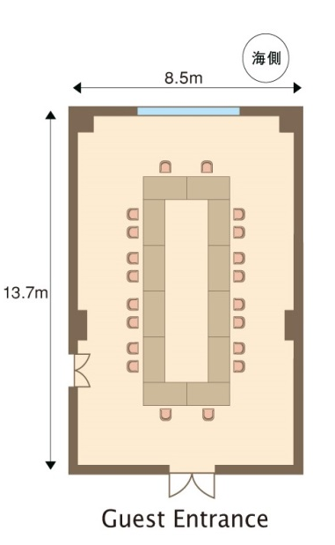
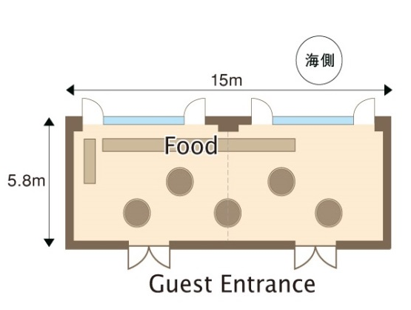
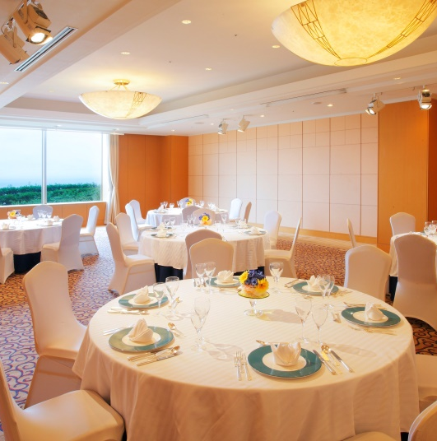
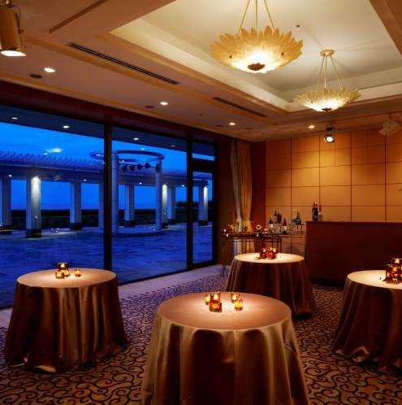
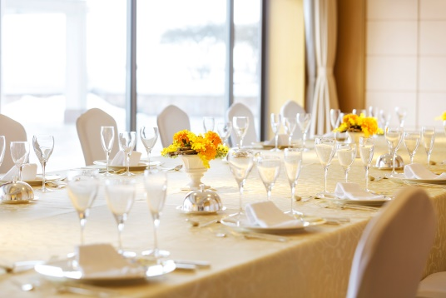
Board Meetings
5F UMI
Area 116 square meters
Footage 8.5m
Depth 13.7m
Ceiling 3.4m
5F TSUKI
Area 81 square meters
(Configurable into 2 rooms)
Footage 15.0m
Depth 5.8m
Ceiling 3.4m

Slide 17
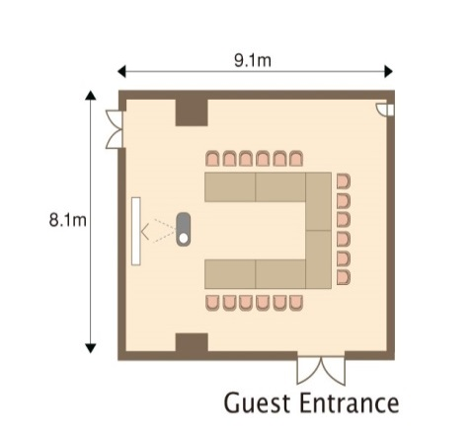
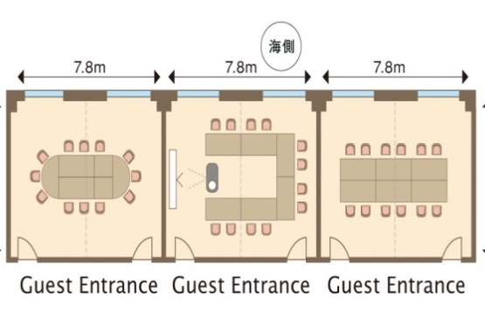

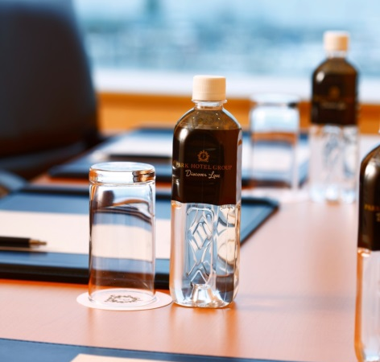
Board Meetings
5F HOSHI
Area 73 square meters
Footage 9.1m
Depth 8.1m
Ceiling 3.3m
6F OSHIDORI/SUEHIRO/KOTOBUKI
Area 53 square meters
(Configurable into 2 rooms)
Footage 7.8m
Depth 6.4m
Ceiling 3.3m
Includes Wi-Fi Internet access, audio-visual equipment such as microphone, screen, projector, white board, flip chart,
meeting mats, pens and pads

Slide 18
Banquet Fact Sheet
Area size and Capacity

Slide 19
SINGAPORE
Grand Park Orchard
Grand Park City Hall
Park Hotel Clarke Quay
Park Hotel Alexandra
Park Hotel Farrer Park
Destination Singapore Beach Road
INDONESIA
Park Hotel Nusa Dua Bali
HONG KONG
Park Hotel Hong Kong
JAPAN
Grand Park Otaru
AUSTRALIA
Park Hotel Melbourne (2022)
CHINA
Grand Park Xian
Grand Park Wuxi
Grand Park Kunming
MALAYSIA
Park Hotel Malacca (2021)
KOREA
Park Hotel Yeongdeungpo
MALDIVES
Grand Park Kodhipparu
GLOBAL SALES OFFICE (17)
Singapore | Jakarta | Hong Kong
Beijing | Shanghai | Guangzhou | Seoul
Tokyo | Mumbai | Bengaluru | Gurgaon
Sydney | London | New York | Phoenix
GDS CODE: PG
parkhotelgroup.com

Slide 20
Contact Us
Grand Park Otaru
T: 81 (0)134 21 3422 F: 81 (0)134 21 3403
E: sales.gpot@parkhotelgroup.com
Ms. Yoneyama: kanako.yoneyama@parkhotelgroup.com
Tokyo Sales Office
T: 81 (0)3 4405 9467 F: 81 (0)3 6701 7585
Ms. Maggie: maggie.zhang@parkhotelgroup.com

Slide 21


